Slide 1

Trace-element based exercises

Slide 2


14.2: Fractional crystallization
(direct trc)
Exercise
The Table shows the REE concentrations in a tonalitic magma (ppm), as well as the partition coefficients for crystallizing mineral phases.
 | Concentration | Partition coefficients
 | Source H34 | Pl | Amp | Ilm
La | 32.04 | 0.4 | 0.74 | 0.005
Ce | 61.9 | 0.27 | 1.52 | 0.006
Nd | 25.75 | 0.21 | 4.26 | 0.0075
Sm | 3.97 | 0.13 | 7.77 | 0.01
Eu | 0.966 | 2.15 | 5.14 | 0.007
Gd | 2.3 | 0.097 | 10 | 0.017
Dy | 1.16 | 0.064 | 13 | 0.028
Er | 0.46 | 0.055 | 12 | 0.035
Yb | 0.37 | 0.049 | 8.4 | 0.075
Lu | 0.057 | 0.046 | 6 | 0.1
ttg_a.data
A differentiated magma is generated by 30% fractional crystallization of a parental magma (H34); the cumulate consists of plagioclase, hornblende and ilmenite.
Calculate the differentiated magma composition for a cumulate made up of 49 % plagioclase, 49 % hornblende, and 2 % ilmenite.
By means of the GCDkit function spider, plot chondrite-normalized REE patterns (using normalization values after Boynton 1984).

Slide 3
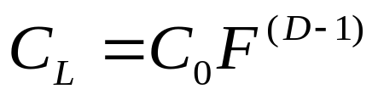
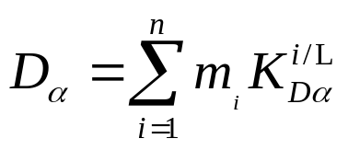

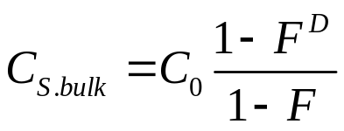
14.2: Fractional crystallization (direct trc)
Rayleigh equation:
Eq. [11.5]
where bulk distribution coefficient D for element α:
Eq. [10.4]
From definition of D, instantaneous solid:
Eq. [11.8],
CORRECTED FROM THE BOOK
The bulk solid:
Eq. [11.9]

Slide 4
15.1: Fractional crystallization
(reversed Ex. 14.2)
Exercise
Table contains trace-element compositions of two tonalites, a primitive WR1 and a differentiated WR2, together with corresponding partition coefficients for the relevant rock-forming minerals.
 | WR1 | WR2 | Pl | Amp | Ilm
La | 32.04 | 1.224 | 0.4 | 0.74 | 0.005
Ce | 61.9 | 2.270 | 0.27 | 1.52 | 0.006
Nd | 25.75 | 1.170 | 0.21 | 4.26 | 0.0075
Sm | 3.97 | 0.158 | 0.13 | 7.77 | 0.01
Eu | 0.966 | 0.320 | 2.15 | 5.14 | 0.007
Gd | 2.3 | 0.119 | 0.097 | 10 | 0.017
Dy | 1.16 | 0.085 | 0.064 | 13 | 0.028
Er | 0.46 | 0.057 | 0.055 | 12 | 0.035
Yb | 0.37 | 0.101 | 0.049 | 8.4 | 0.075
Lu | 0.057 | 0.025 | 0.046 | 6 | 0.1
ttg_a2.data
Let’s assume that WR1 and WR2 represent pure compositions of a tonalitic melt differentiating by Rayleigh-type fractional crystallization.
Using the least-square method, estimate the modal composition of the cumulate and the degree of fractional crystallization.

Slide 5
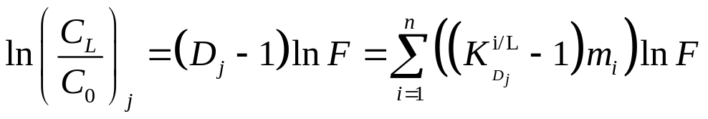
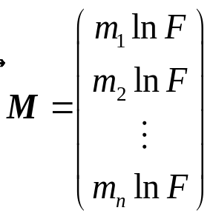
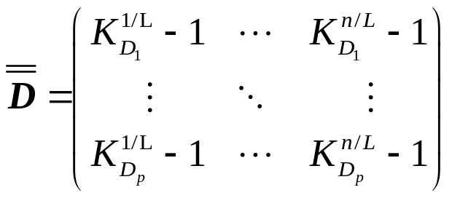
15.1: Fractional crystallization
(reversed Ex. 14.2)
From Rayleigh equation [11.5]:
Eq. [12.1]
Defining the unknown as a vector of length n:
Eq. [12.2]
Matrix of partition coefficients (less one):
Eq. [12.3]

Slide 6
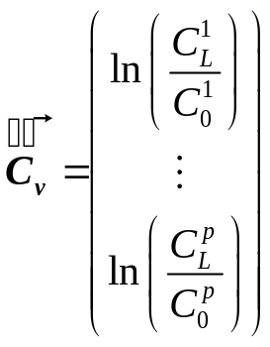
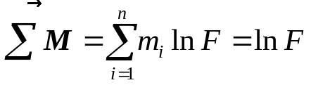
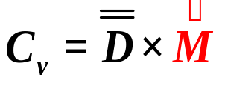
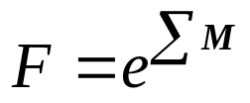
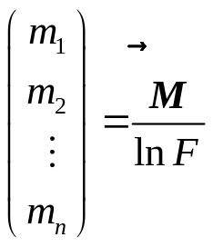
15.1: Fractional crystallization
(reversed Ex. 14.2)
Defining vector of left
hand sides in Eq. 12.1:
Eq. [12.4]
We can rewrite the Eq. 12.1 in a matrix form and solve by least squares:
Then:
Eq. [12.5]
Eq. [12.7]
Least-squares method is in R implemented by the function lsfit setting intercept = FALSE, so that the model passes through the origin.
Eq. [12.8]

Slide 7
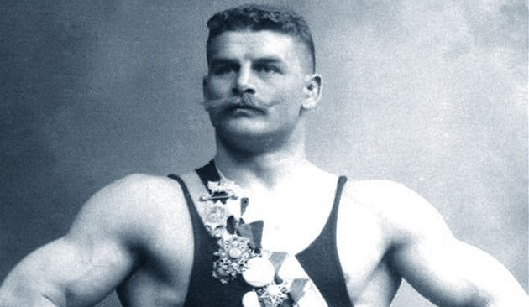
Accessories and saturation exercises

Slide 8
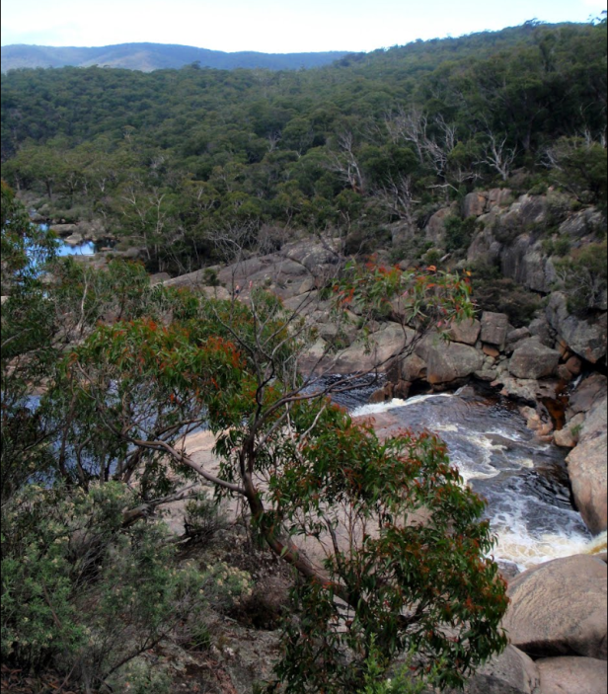
14.5 (completed): Saturation models for accessory minerals
Exercise
The file contains major-element and Zr contents in Boggy Plain Suite of the Lachlan Fold Belt (New South Wales, Australia) [Wyborn, 1983; OzChem compilation http://www.ga.gov.au]
boggy_plain_data.data
Based on the Watson and Harrison’s (1983) zircon saturation model, in GCDkit:
  Plot a binary graph SiO₂ vs. Zr for the Boggy Plain Suite showing the inflected trend characteristic of the saturation in zircon
  Plot a binary graph of M vs. Zr (ppm) with superimposed isotherms of zircon saturation temperatures in ºC [Eq. (13.3)].
  Plot a binary plot SiO₂ vs. Zr saturation temperature in ºC for the same

Slide 9
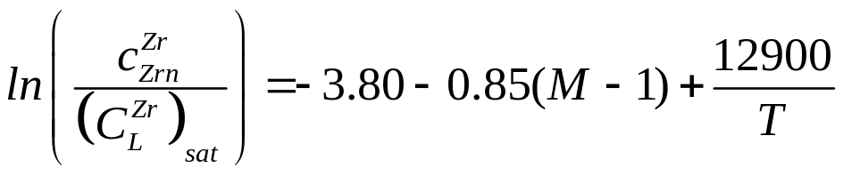

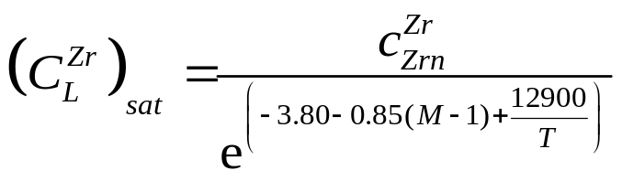
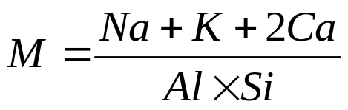
14.5 (completed): Saturation models for accessory minerals
Saturation equation (Watson & Harrison 1983):
Eq. [13.1]
Which can be transformed to
= 497644 ppm (49.7 wt. %)
GCDkit saturation plugin:
zrSaturation(T=…)
Returns a matrix with columns:
M, Zr, Zr.sat, TZr.sat.C

